Slide 1


INTERNATIONAL CONVENTION
WORLD FEDERATION OF TOURIST GUIDE ASSOCIATIONS
WFTGA 2013
Macau, China 14-18 January 2013
Mr. Márcio Favilla L. de Paula
Executive Director, Competitiveness, External Relations and Partnerships
UNWTO

Slide 2

Results 2011
International Tourist Arrivals
990 million
+5.0%
International Tourism Receipts
(BOP Travel)
US$ 1,035 billion (euro 740 bn)
+3.9% (real terms)
+
International passenger transport
(BOP Transport, passenger)
US$ 203 billion (euro 144 bn)
www.unwto.org/facts

Slide 3
Inbound tourism: World
Source: World Tourism Organization (UNWTO)

Slide 4
growth in receipts follows growth in arrivals closely
International Tourism Arrivals and Receipts, World
Asian financial and economic crisis: receipts grew slower
11S, SARS, economic downturn: receipts more affected
‘Great recession’: receipts more affected and slower to recover
Source: World Tourism Organization (UNWTO)
Notes:
4

Slide 5
INTERNATIONAL TOURISM 2011*
International tourist arrivals and receipts and market share (%)
International Tourist Arrivals (ITA) 990 million |  | International Tourism Receipts (ITR) US$ 1,035 billion
Europe
ITA: 509 million (51%)
ITR: US$ 464 billion (45%)
Middle East
ITA: 56 million (6%)
ITR: US$ 47 bn (5%)
Asia and the Pacific
ITA: 218 million (22%)
ITR: US$ 291 billion (28%)
Americas
ITA: 157 million (16%)
ITR: US$ 199 billion (19%)
Africa
ITA: 50 million (5%)
ITR:US$ 33 billion (3%)
Source: World Tourism Organization (UNWTO)
Notes:
5

Slide 6
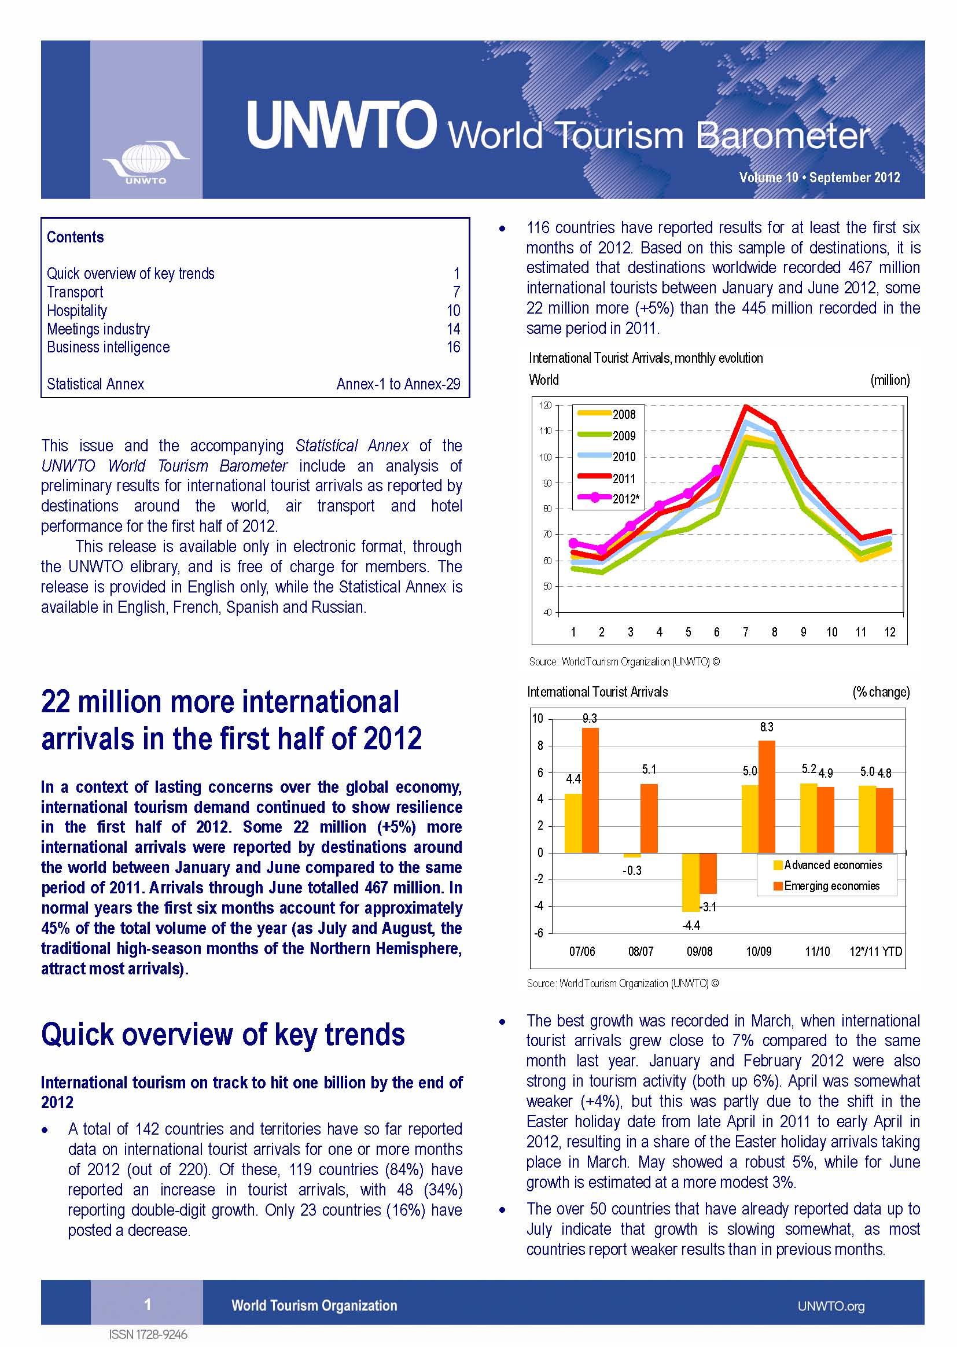
Results
2012
www.unwto.org/facts

Slide 7
International tourism continues to grow strongly
+2.1%
-3.9%
+6.6%
+5.0%
+4.1%
Notes:
7

Slide 8
+1.1%
-1.6%
+13.2%
+6.4%
+7.3%

Slide 9
Emerging destinations suffered less in
the crisis and recovered quicker

Slide 10
2012: positive growth in all regions except ME
Notes:
10
Following a year of global recovery in 2010, grwoth is expected to continue for the tourism sector in 2011, but at a slower pace.
UNWTO forecasts increase ITA of between 4% -5% in 2011 – rate slightly above long-term average.
10

Slide 11
International tourism: projection full year 2012
 | 2011 (Full year) | Forecast 2012 (done January) | YTD 2012 (Jan.-Aug.)
World | +5.0% | 3% to 4% | 4.1%
Europe | +6.7% | 2% to 4% | 3.4%
Asia and the Pacific | +6.4% | 4% to 6% | 7.3%
Americas | +4.2% | 2% to 4% | 3.6%
Africa | +0.3% | 4% to 6% | 6.1%
Middle East | -7.0% | 0% to 5% | -1.4%
Source: World Tourism Organization (UNWTO)
Notes:
11

Slide 12
Outlook: World
Forecast
2012: 3% to 4%
2013: 2% to 4%
change (%)
Source: World Tourism Organization (UNWTO)
Notes:
12
Following a year of global recovery in 2010, grwoth is expected to continue for the tourism sector in 2011, but at a slower pace.
UNWTO forecasts increase ITA of between 4% -5% in 2011 – rate slightly above long-term average.
12

Slide 13

Tourism towards 2030

Slide 14

International arrivals to reach
1.4 billion in 2020 and 1.8 billion by 2030
Average annual growth 2010-2030: +3.3%
+ 43 million
1.8 bn
1.4 bn
1 bn
Notes:
14
International tourism is expected to continue growing, but to a slightly reduced pace of growth -> 3.3% compared to 3.9% average for the period 1995-2010.
Four factors:
- Statistical effect: increased volumes mean reduced rates of growth (it becomes important to observe volumes rather than % change)
- Reduced GDP growth, as economies become more mature
Reduced elasticity of travel to GDP; as affluence increases, a marginal increase in GDP corresponds to a smaller increase in the number of arrivals generated by a country
A shift from falling costs of transport to increasing ones
43 million ITA per year on average -> arrivals to Italy1

Slide 15
Growth in international tourism will continue,
but at a more moderate pace
Average annual growth
2010 – 2030 : 3.3%
2010 - 2020
2020 - 2030
3.8 %
2.9%
Average annual growth
Average annual growth
1980 – 1995: 4.4%
1995 – 2010: 3.9%
Notes:
15

Slide 16
International tourist arrivals to increase
by 43 million a year on average
Average growth
2010 – 2030 : +43 mn
2010 - 2020
2020 - 2030
+42 mn
+ 45 mn
Average growth
Average growth
1980 – 1995: +17 mn
1995 – 2010: +28 mn
Notes:
16

Slide 17
Emerging economies destinations to surpass advanced destinations by 2015
1,037 mn
552 mn
523 mn
772 mn
540 mn
457 mn
Notes:
17

Slide 18
Asia and the Pacific, the Middle East
and Africa to increase their shares
1980 (277 mn)
2010 (940 mn)
2030 (1.8 bn)
Notes:
18

Slide 19
Asia and the Pacific will also be the
outbound region that grows most
832 mn
509 mn
541 mn
205 mn
265 mn
160 mn
81 mn
37 mn
90 mn
30 mn
Notes:
19

Slide 20
Asia and the Pacific will gain most
of the new arrivals
744 mn
475 mn
535 mn
204 mn
248 mn
150 mn
61 mn
149 mn
50 mn
134 mn
Notes:
20

Slide 21
Emerging
markets

Slide 22
Growth: Driven by emerging destinations
Source: World Tourism Organization (UNWTO)
Notes:
Steady and rapid growth emerging economies: 442 million arrivals emerging economies vs 498 million arrivals advanced in 2010

Slide 23
Growth: Driven by emerging destinations (share)
Source: World Tourism Organization (UNWTO)
Notes:
Share difference narrowing over the years: emerging economies (47%) vs advanced economies (53%) in 2010

Slide 24
Most arrivals within own region
Source: World Tourism Organization (UNWTO)
Notes:
Most arrivals within own region

Slide 25
Diversification of destinations
Notes:
25
Diversification of destinations
More destinations taking part in international tourism, more competition
Emerging destinations among top 15, which was dominated by traditional ones: China (3rd, ousting Spain in 2010), Turkey, Russian Fed, Malaysia…

Slide 26
Average annual growth: 2000-2011*
Source: World Tourism Organization (UNWTO)
Notes:
(sub) regions grew above the world average between 2000-2010:
Middle East, South-East Asia, North-East Asia, Subsaharan Africa, Central America, South Asia, South America

Slide 27
Emerging markets characteristics
Sizeable population → still limited number taking part in international tourism → huge growth potential
Economies rapid economic growth → disposable incomes increase
A relative big share of this increase will be spent on tourism (domestic as well as international)
Emerging middle classes:
  Growing proportion of population able to take part and taking part in tourism
Increasing frequency of existing travelers
Increased competition →diversification strategies
Notes:
27
Diversification of destinations
More destinations taking part in international tourism, more competition
Emerging destinations among top 15, which was dominated by traditional ones: China (3rd, ousting Spain in 2010), Turkey, Russian Fed, Malaysia…

Slide 28
World’s Top Economies in 2030: BRICS on the spot
Country GDP 2010 (USD trn)
Country GDP 2030 (USD trn)
USA
China
Japan
Germany
France
UK
Italy
Brazil
Russia
Canada
India
Spain
Australia
Mexico
Korea (ROK)
14.6
5.6
4.8
3.6
2.9
2.6
2.3
2.0
1.7
1.6
1.6
1.5
1.2
1.1
1.0
China
USA
India
Brazil
Japan
Russia
Germany
France
UK
Mexico
Italy
Canada
Korea (ROK)
Spain
Australia
31.7
22.9
8.0
5.9
5.9
4.7
4.4
4.2
3.6
3.0
2.9
2.3
2.1
2.0
1.8
Source: IMF
Projection in 2010 constant dollars; source: Goldman Sachs

Slide 29
Fast-growing emerging destinations
Inbound tourism 2000 - 2011
0,8

Slide 30
Emerging markets increasing expenditure abroad
International tourism expenditure 2000 - 2011
2
1
3
2
3
4
5
4
9
7
5
12
18
15
7
17
23
12
26
18
15
32

Slide 31
International tourism expenditure in major outbound markets: BRICs are hot
C
B
R
I

Slide 32

Everybody chasing the Chinese tourist…

Slide 33
China Outbound Travel Market
China is the most populated country in the world and the world’s second largest economy. China is also one of the fastest growing travel markets in the world, both in terms of international visitor arrivals and expenditure abroad
China is the third largest spender in the world after Germany (US$ 86 billion) and the United States (US$ 79 billion). Chinese travellers spent US$ 73 billion in 2011, a more than three-fold increase from 2005, when expenditure was US$ 22 billion.
Thanks to rising disposable incomes, rapid urbanization and relaxations of restrictions on foreign travel, outbound trips from China have grown an average 19% a year since 2000. Chinese had taken 34.5 million trips abroad (2006). By 2011, this figure had risen to over 70 million, and continues to increase steadily.
Source: World Tourism Organization (UNWTO)

Slide 34



UNWTO reports on
Outbound Markets
The Indian Outbound Travel Market (2007)
The Chinese Outbound Travel Market (2008) (new update forthcoming, 2012)
The Russian Outbound Travel Market (2009)
The Middle East Outbound Travel Market (2012)
The US Outbound Travel Market (2013)
The Latin American Outbound Travel Market (2013)
The Brazil Outbound Market (2013)
Notes:
34

Slide 35


Tourism in the global agenda
G20 recognizes for the first time Travel and Tourism as a vehicle for job creation, economic growth and development, and commits to work on travel facilitation
Rio+20 recognizes the significant contribution of sustainable tourism to the three dimensions of sustainable development, its linkages to other sectors and its capacity to create decent jobs and trade opportunities.

Slide 36
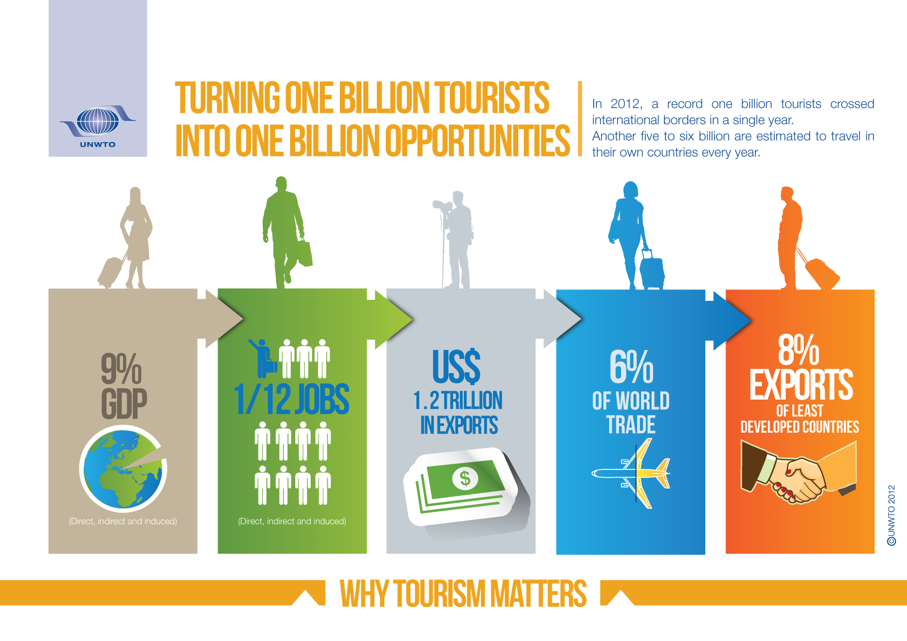
Notes:
36

Slide 37
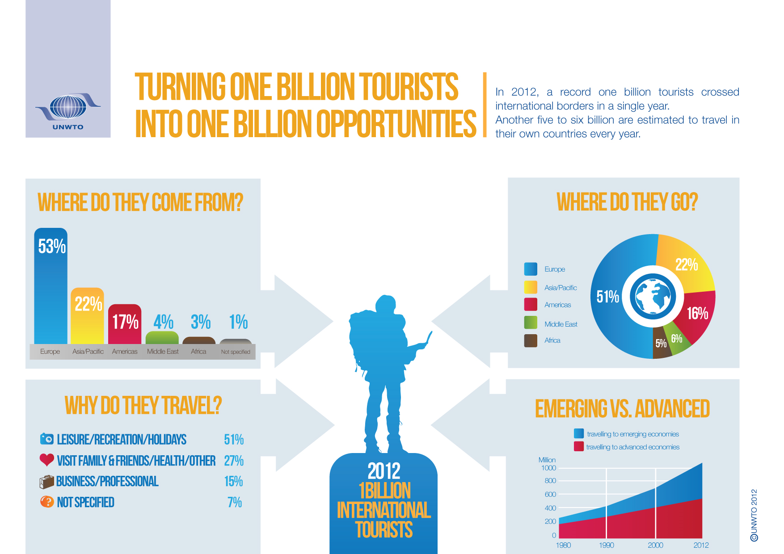
Notes:
37

Slide 38
Thank you very much for your attention!
World Tourism Organization (UNWTO)
www.unwto.org

Slide 39
Notes:
39
International tourism is expected to continue growing, but to a slightly reduced pace of growth -> 3.3% compared to 3.9% average for the period 1995-2010.
Four factors:
- Statistical effect: increased volumes mean reduced rates of growth (it becomes important to observe volumes rather than % change)
- Reduced GDP growth, as economies become more mature
Reduced elasticity of travel to GDP; as affluence increases, a marginal increase in GDP corresponds to a smaller increase in the number of arrivals generated by a country
A shift from falling costs of transport to increasing ones
43 million ITA per year on average -> arrivals to Italy1

